Slide 1

TMDb Movies Research
Datadoctors team:
Michael Rutkowski
Jing Xu
Deepa Karnani
"This product uses the TMDb API but is not endorsed or certified by TMDb."

Slide 2
Researching TMDb Movie database with API
Motivation & Summary
Researched the TMDb Movie Database:
Overview of movie market during time year>1990 for following analysis
Factors that result in greater revenue
Month vs revenue
Budget vs revenue
Genres vs revenue
Average vote vs revenue
Popularity vs revenue
Factors that cause a higher movie rating
Popularity vs average vote
Genres vs average vote
Budget vs average vote
Vader Sentiment Analysis vs average vote
Production Companies that make the highest movies
Do bigger production companies have better budget, personnel or marketing strategists? Higher Profit margin?
Lack of data, need for assumptions

Slide 3
Data Sources including TMDb’s API extraction
Questions & Data
Kaggle’s 2016 movie data set in csv Format (From Year 1927)
https://www.kaggle.com/tmdb/tmdb-movie-metadata
API Calls to TMDb’s API to extract 2017 movies information
API calls for 2017 movie id’s, followed by calls for rest of parameters
Other sources – Wikipedia, IMDb, etc.
https://github.com/mjr390/Movies_Exploration (Shared Folder for Analysis)

Slide 4
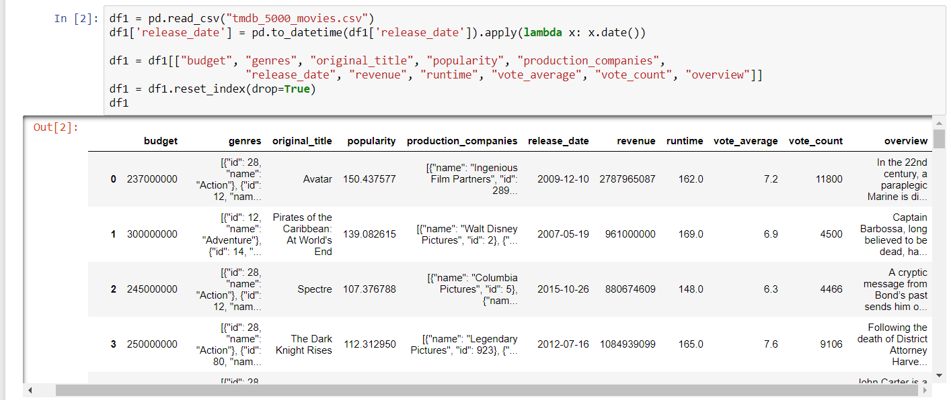
Data Clean Up and Exploration
The 10 Best Film Production Companies
Warner Bros.
Sony Pictures Motion Picture Group
Walt Disney Studios
Universal Pictures
20th Century Fox
Paramount Pictures
Lionsgate Films
The Weinstein Company
Metro-Goldwyn-Mayer Studios
DreamWorks Pictures
Load in a csv from Kaggle
Create a new df using only the wanted rows

Slide 5
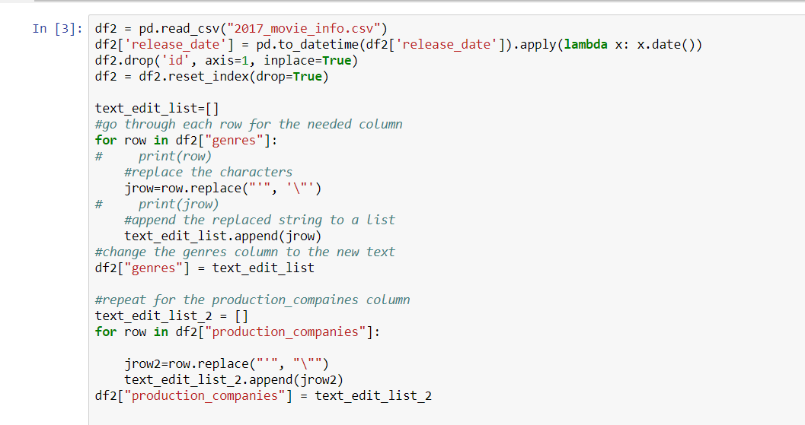
Data Clean Up and Exploration
The 10 Best Film Production Companies
Warner Bros.
Sony Pictures Motion Picture Group
Walt Disney Studios
Universal Pictures
20th Century Fox
Paramount Pictures
Lionsgate Films
The Weinstein Company
Metro-Goldwyn-Mayer Studios
DreamWorks Pictures
Read in a csv created by API calls
The API calls only gathered data for wanted columns
Edit text to be useable

Slide 6
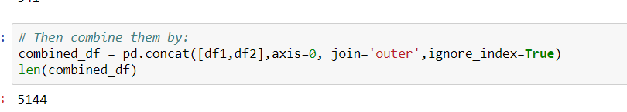
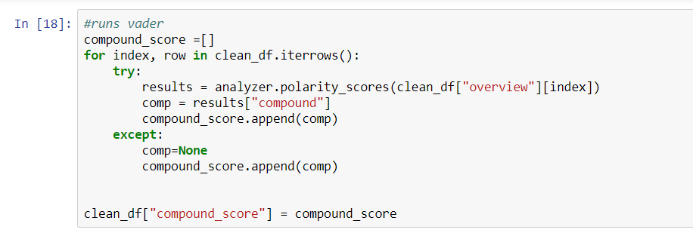
Data Clean Up and Exploration
Combine the two dfs into one
Use sentiment analysis to find the compound score, based on the movie’s overview
Add a new column to the combined df with the compound score

Slide 7
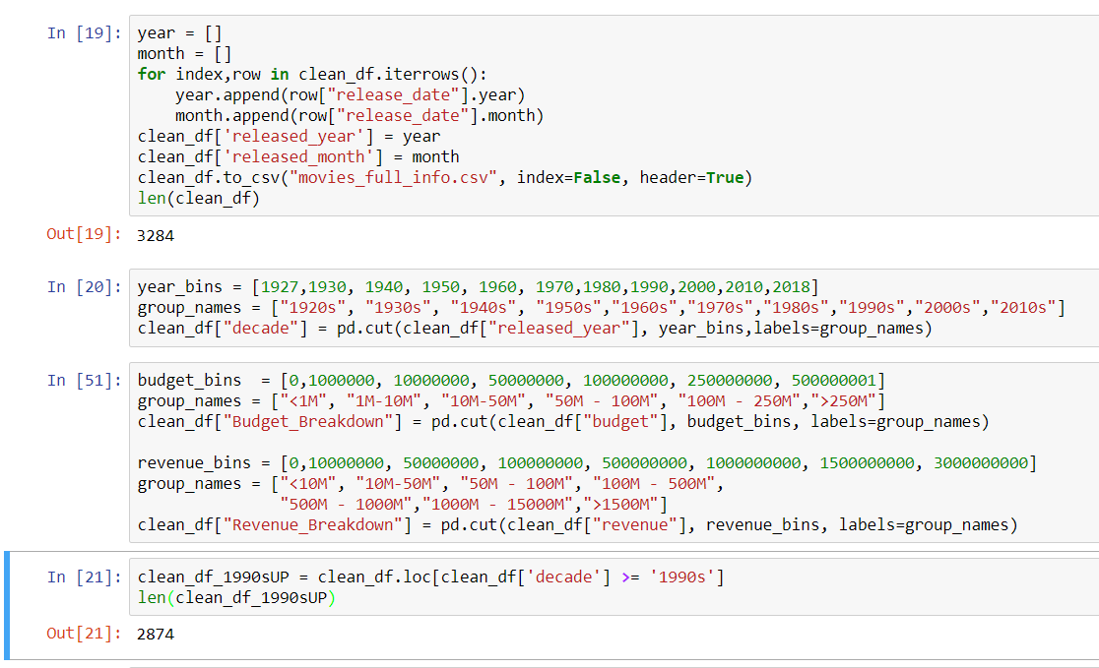
Data Clean Up and Exploration
The 10 Best Film Production Companies
Warner Bros.
Sony Pictures Motion Picture Group
Walt Disney Studios
Universal Pictures
20th Century Fox
Paramount Pictures
Lionsgate Films
The Weinstein Company
Metro-Goldwyn-Mayer Studios
DreamWorks Pictures
Buckets were created to look at segmented data
In order to avoid generational issues a new df taking only data from 1990 on was created

Slide 8
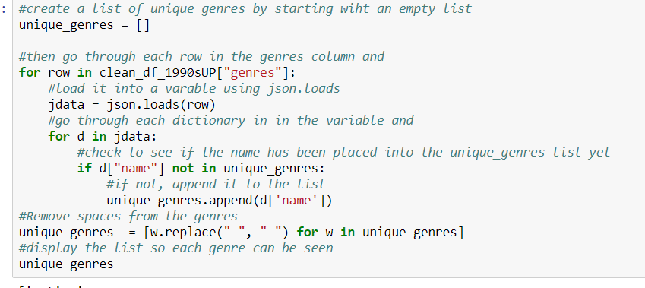
Data Clean Up and Exploration
We wanted to explore how the genres compared to each other
Needed to create dfs based on genre to do that
First by finding what the unique genres are

Slide 9
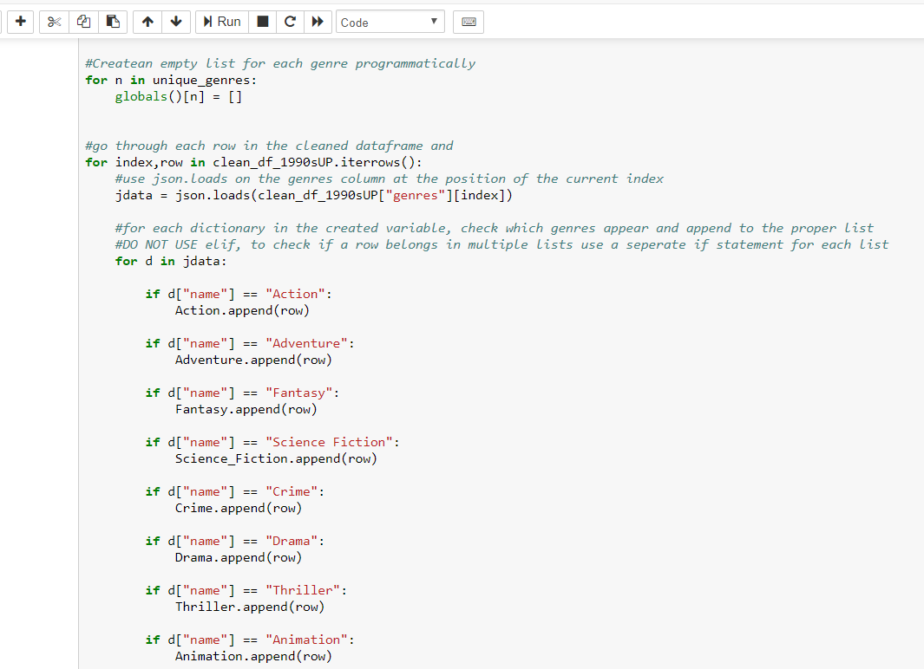
Data Clean Up and Exploration
The 10 Best Film Production Companies
Warner Bros.
Sony Pictures Motion Picture Group
Walt Disney Studios
Universal Pictures
20th Century Fox
Paramount Pictures
Lionsgate Films
The Weinstein Company
Metro-Goldwyn-Mayer Studios
DreamWorks Pictures
Many steps were taken to create these dfs
We started by creating an empty list for each genre in the unique genres list
After, we looped through each row in the 1990s df and stored the data in the ‘genres’ column to a variable
Then, checked which genres appeared in each
And appended the entire row to each genre that the movie belongs
This is why we had to change the text earlier, to read each as a json

Slide 10
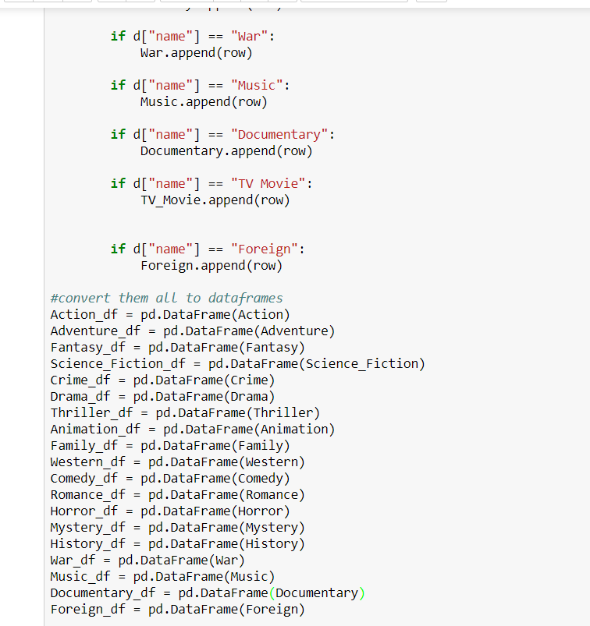
Data Clean Up and Exploration
The 10 Best Film Production Companies
Warner Bros.
Sony Pictures Motion Picture Group
Walt Disney Studios
Universal Pictures
20th Century Fox
Paramount Pictures
Lionsgate Films
The Weinstein Company
Metro-Goldwyn-Mayer Studios
DreamWorks Pictures
After this was completed, a df was created for each genre from the list that corresponds to it
A similar process was used for each production company
We then used these dfs to compare things like how their revenues or voter score averages compare to each other

Slide 11
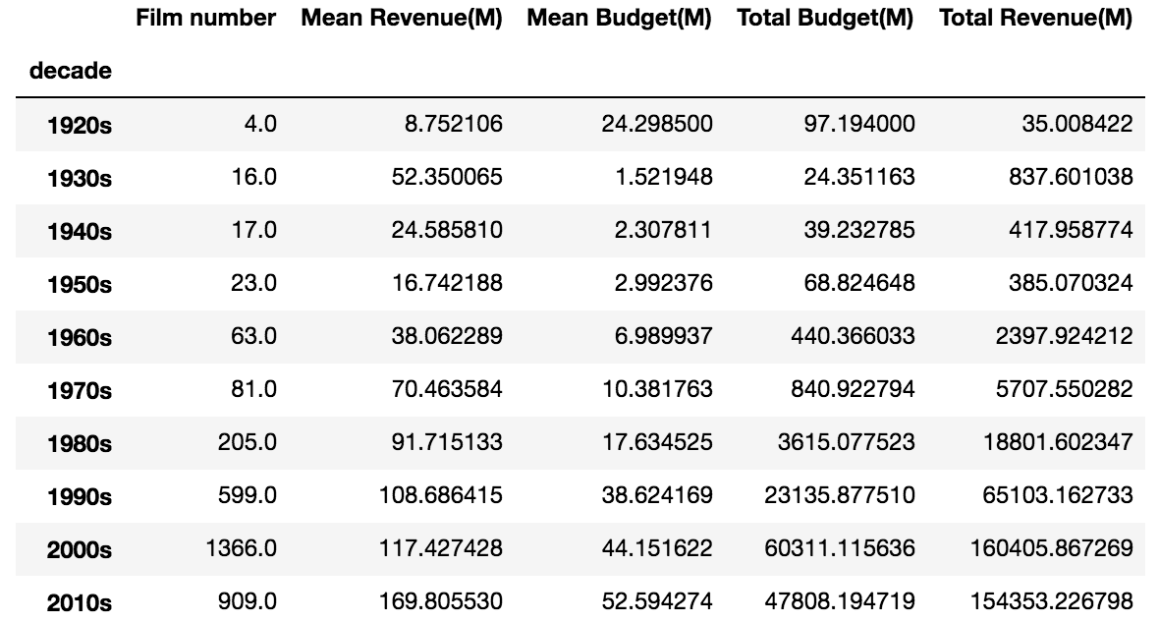
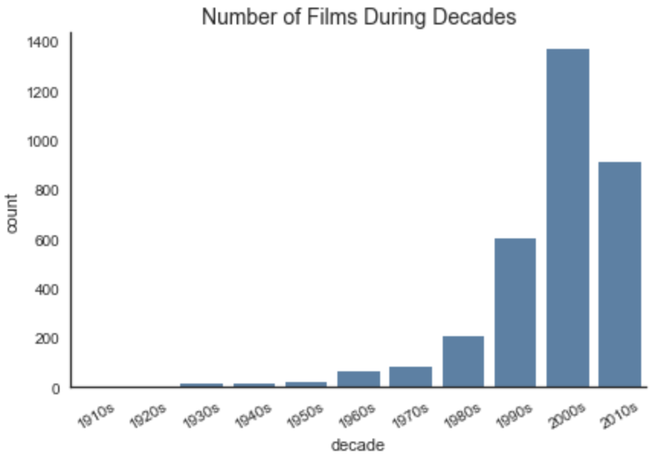
Film market booming from 1990s
Data Analysis
Film number, budget and revenue increased significantly

Slide 12
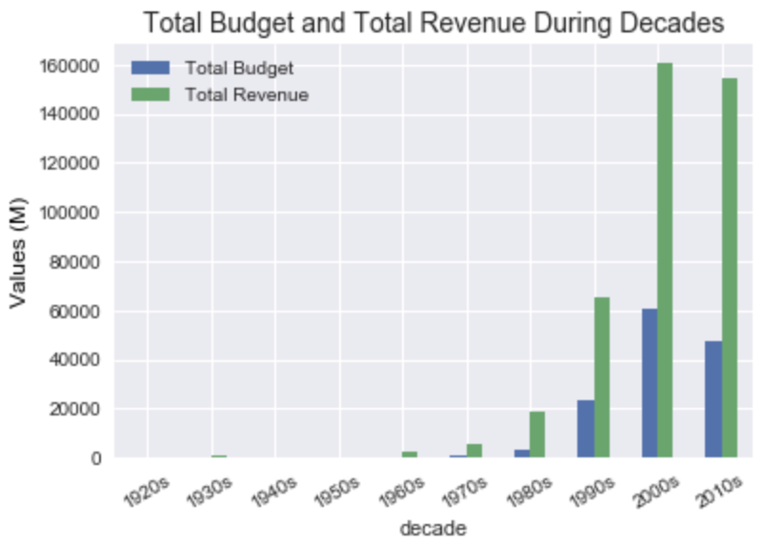
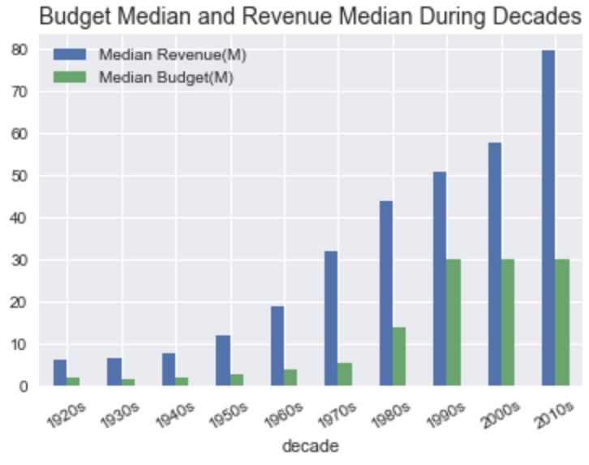
Film market booming from 1990s
Data Analysis
Choose Films Released year >1990 for the following analysis
Total Film Number: 2874

Slide 13
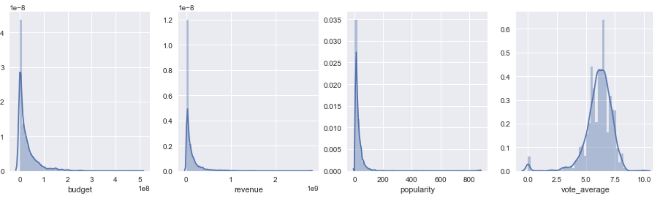
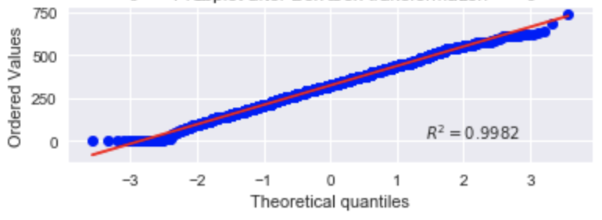
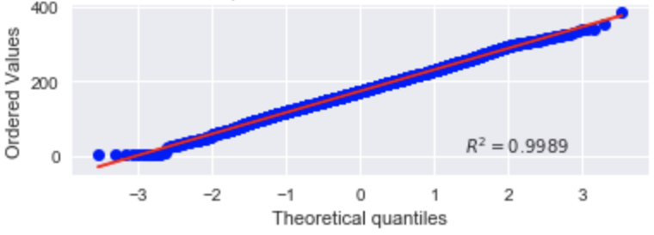
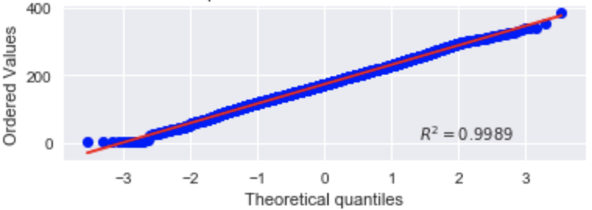
Data Analysis
Original data distribution
Probplot after BOX-COX transformation – Adjusting for skewness of data
budget
revenue
popularity

Slide 14
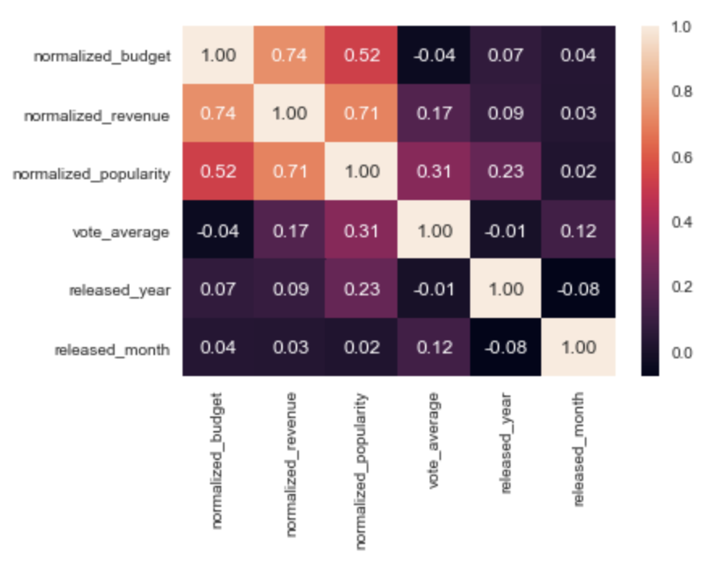
Data Analysis
What factors decide revenue of film?

Slide 15
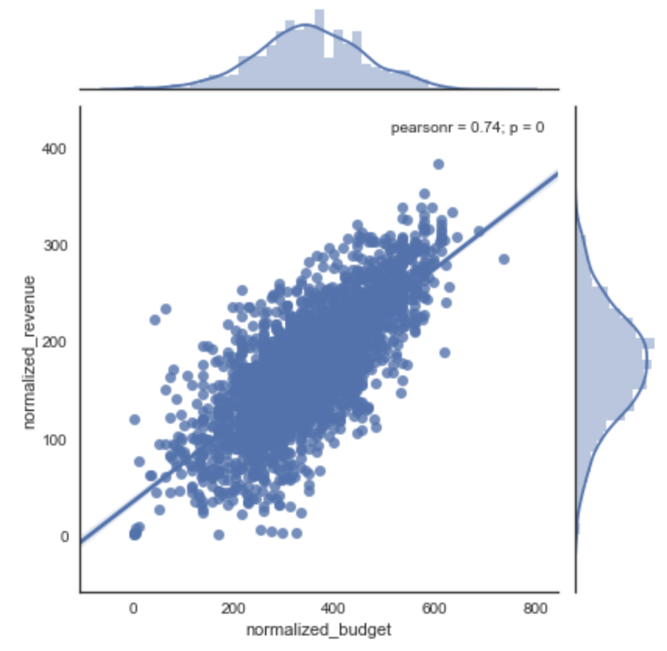
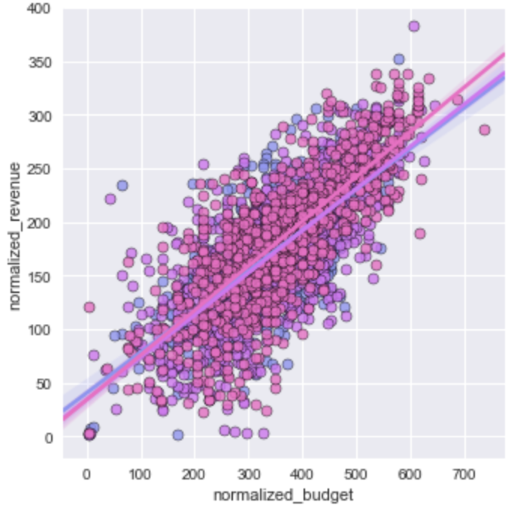
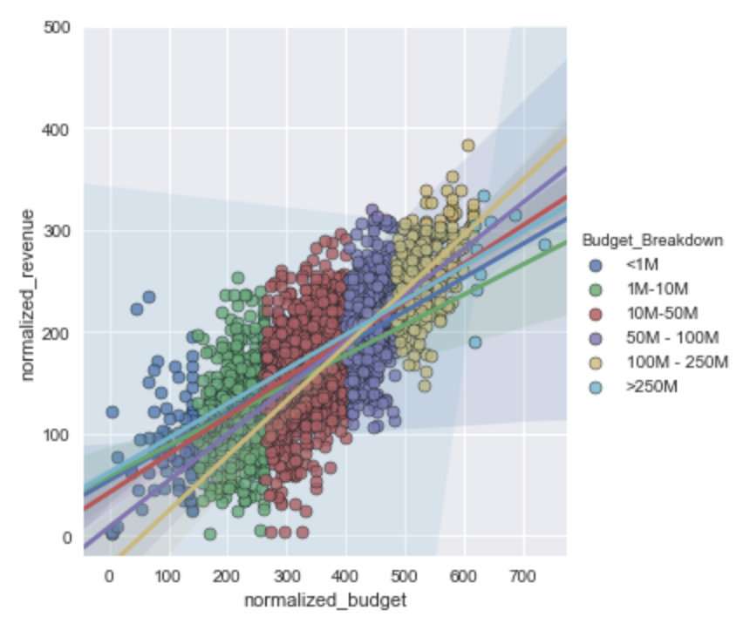
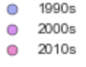
Data Analysis
Budget Vs Revenue

Slide 16
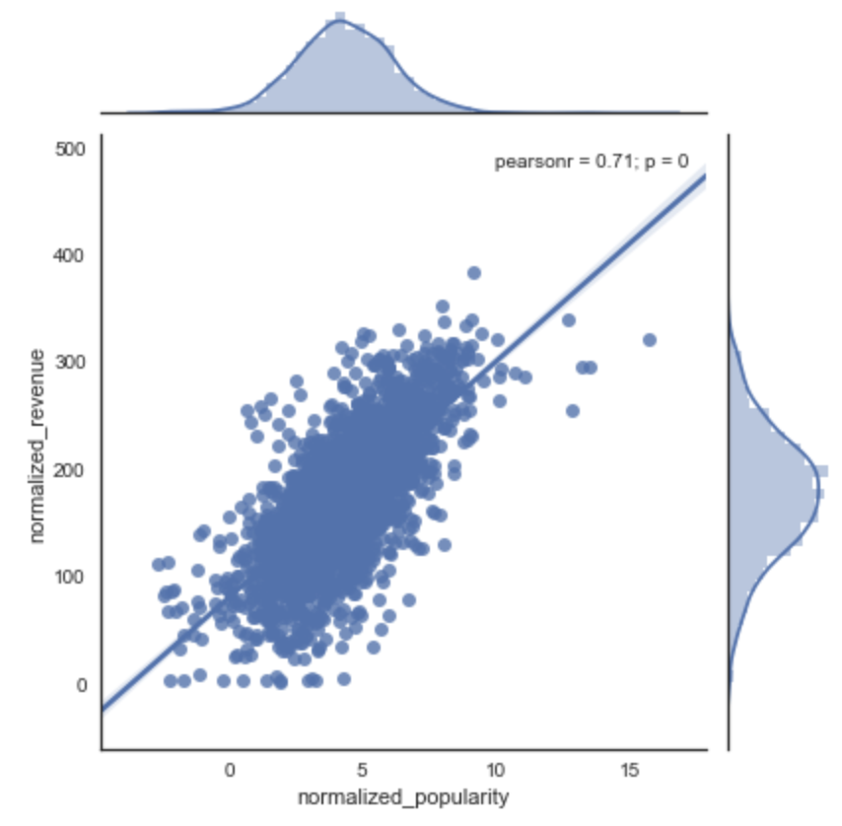
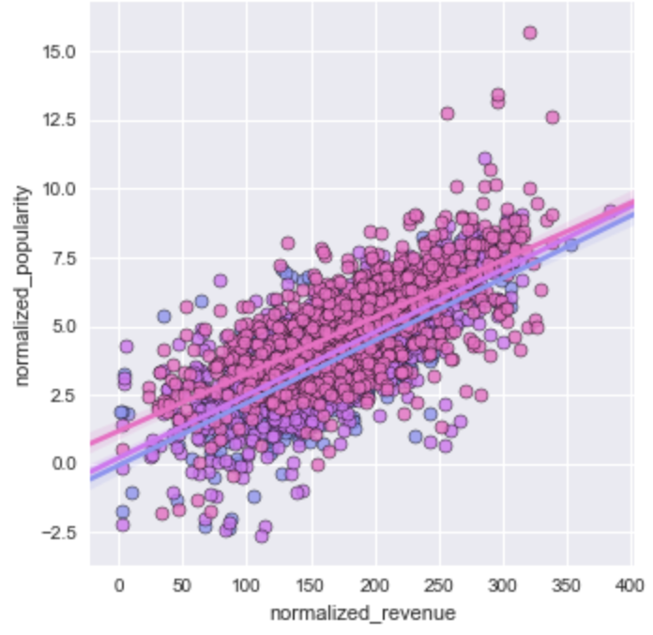
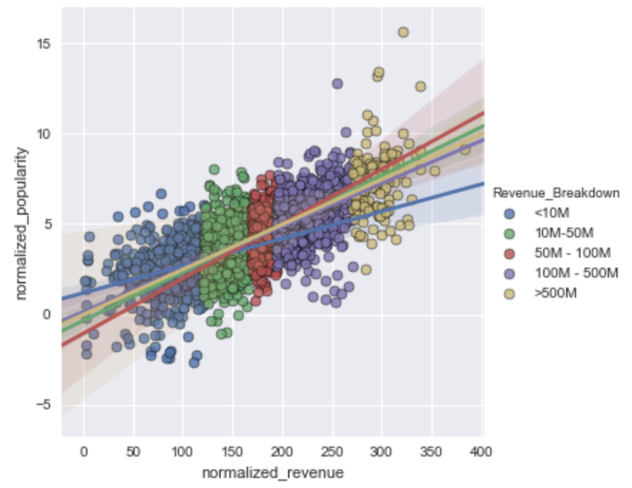
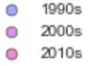
Data Analysis
Popularity Vs Revenue

Slide 17
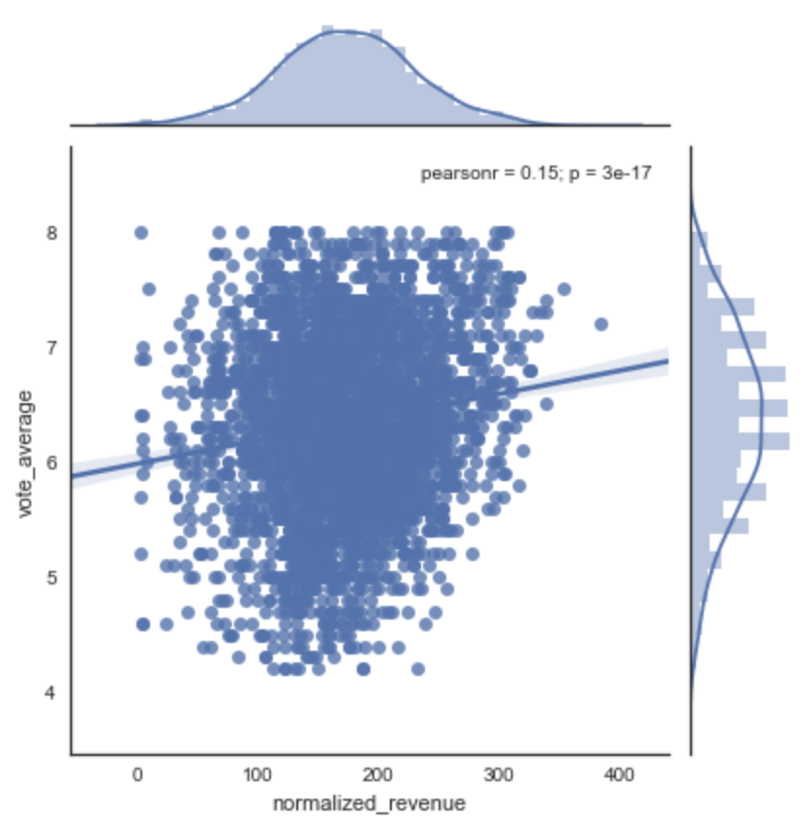
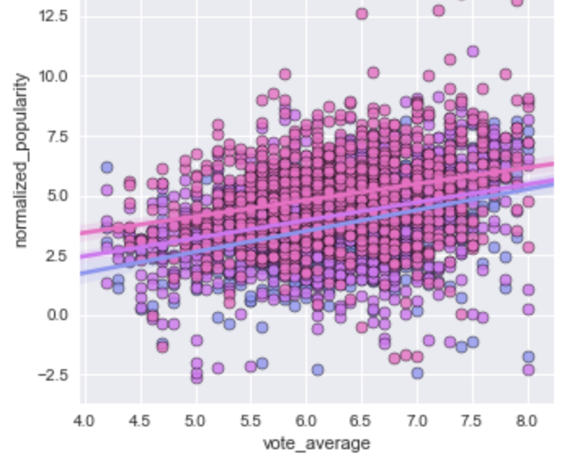
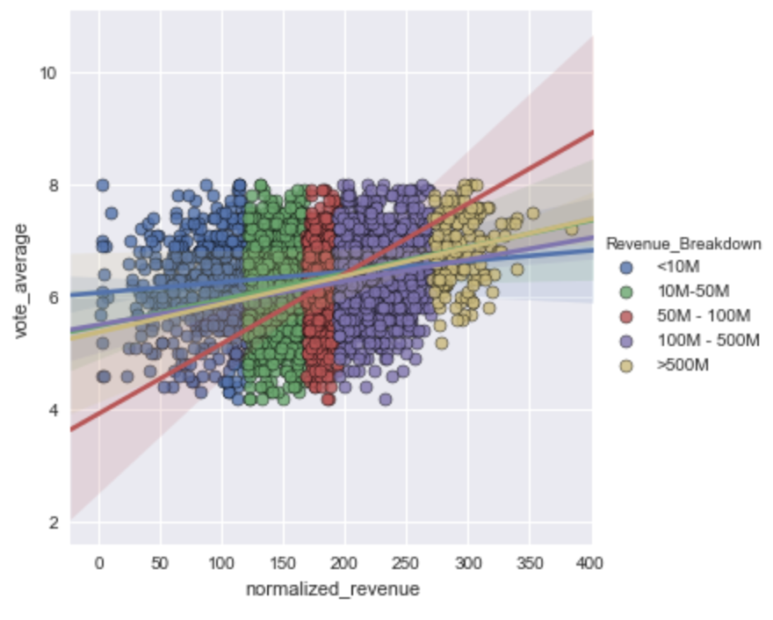
Data Analysis
Rating Vs Revenue

Slide 18
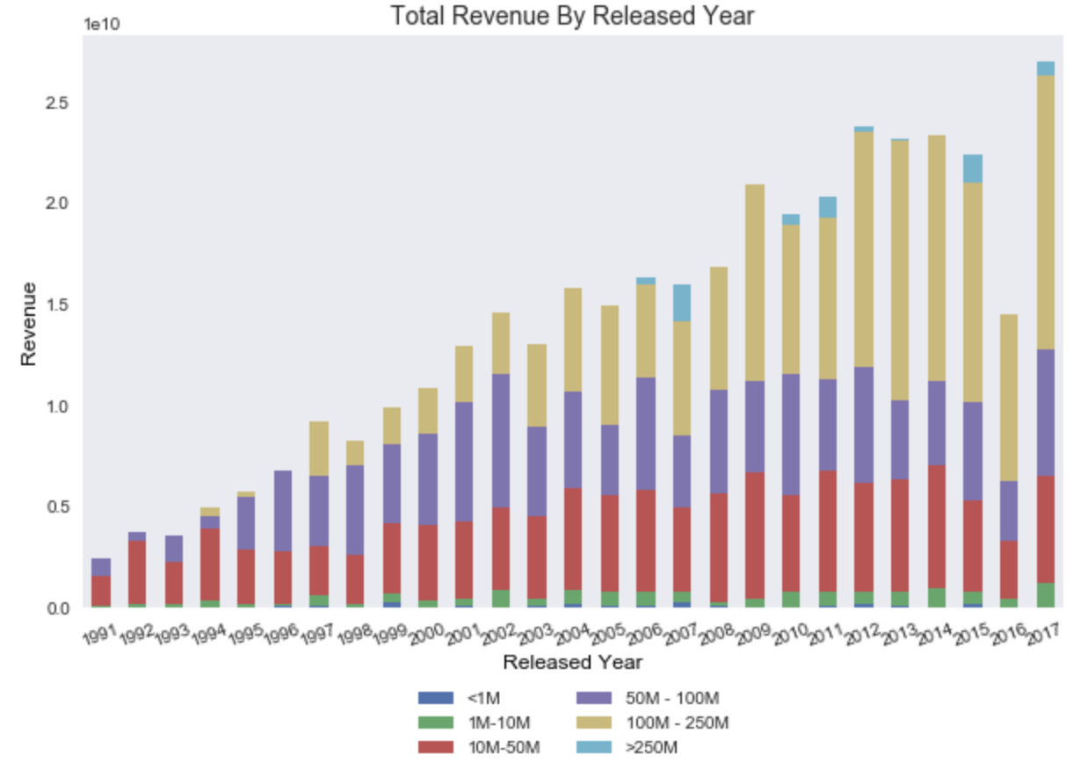
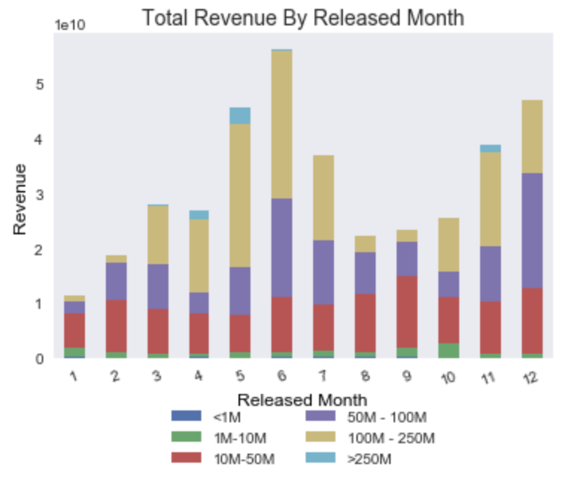
Data Analysis
Released Year Vs Revenue
Released Month Vs Revenue
Budget
Breakdown
Budget
Breakdown

Slide 19
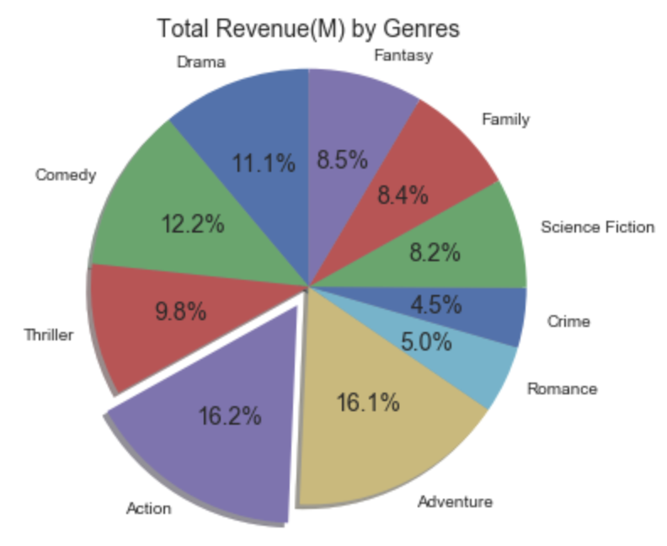
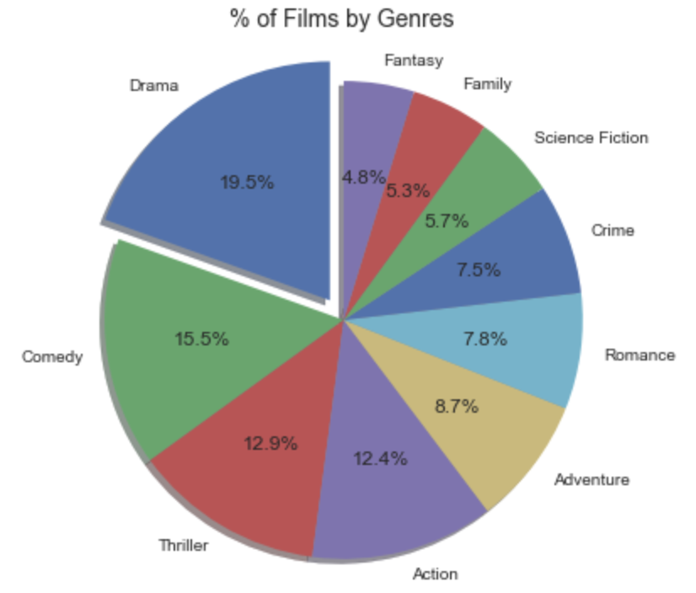
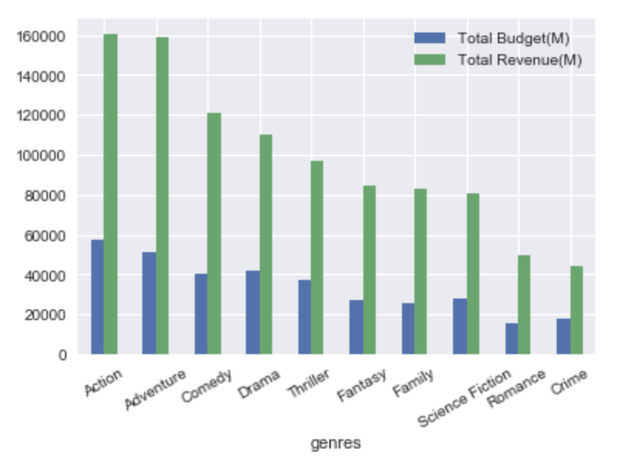
Genres Vs Revenue
Data Analysis
Top ten genres compose
>99.9% of total films
> 87.67 of total revenue

Slide 20
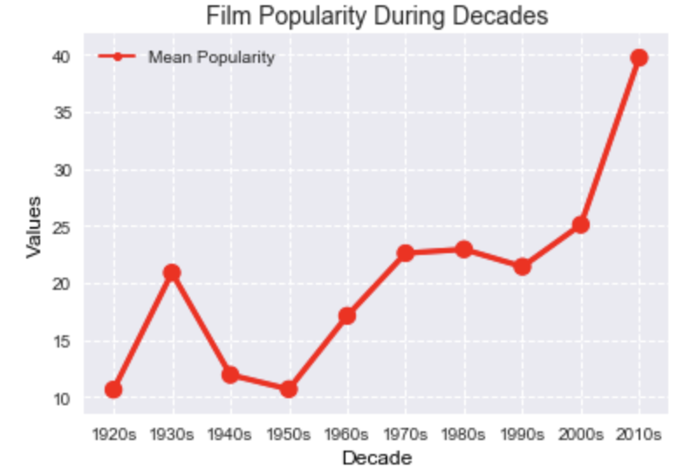
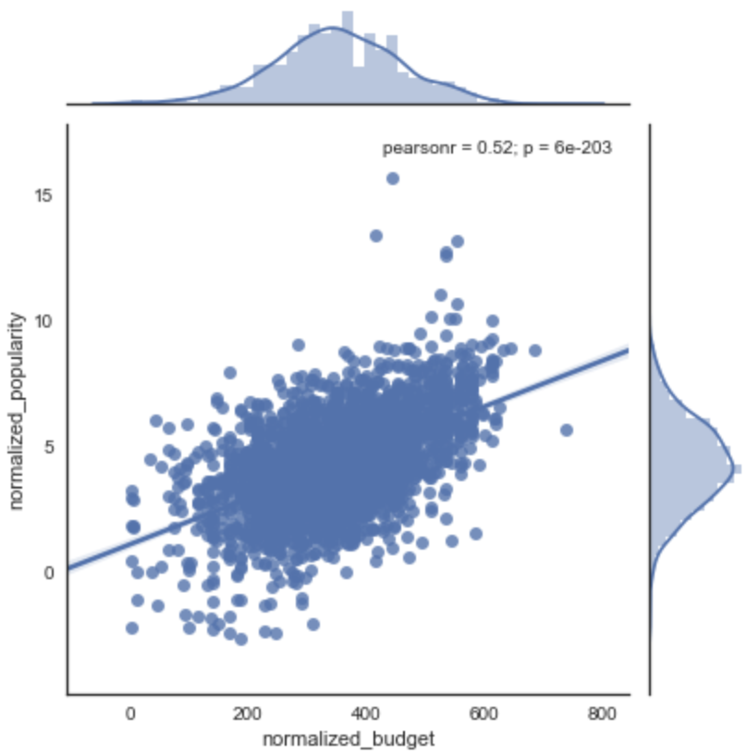
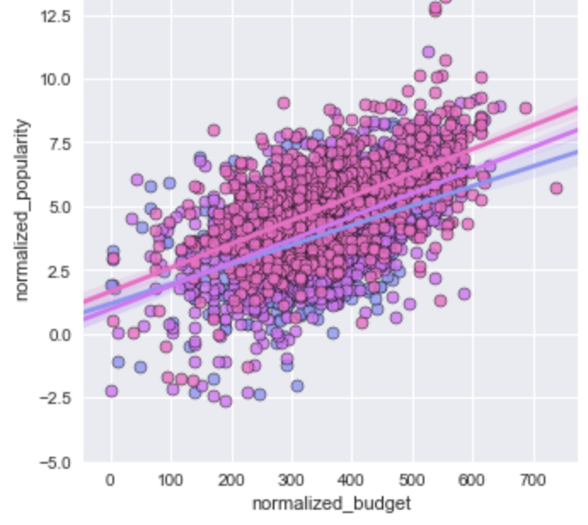
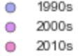
What makes a film popular?
Data Analysis
Popularity & Budget

Slide 21
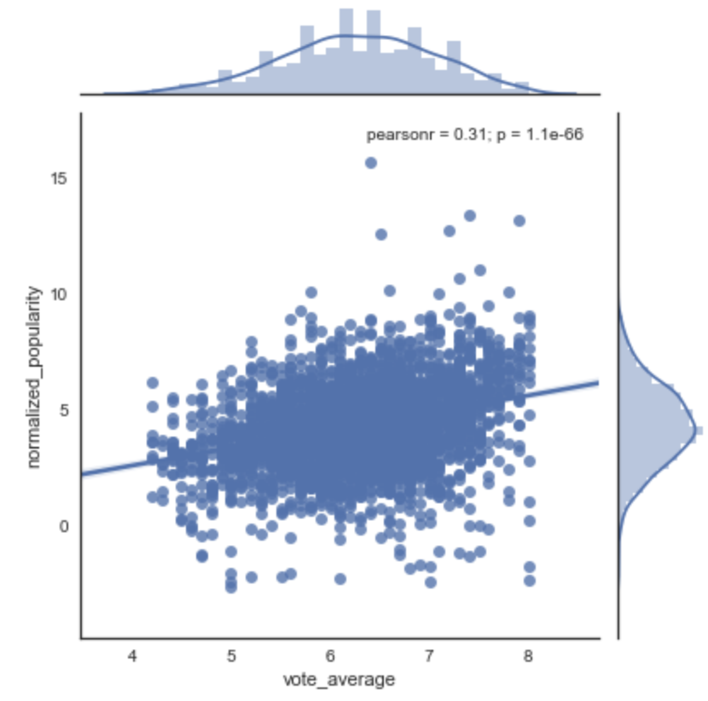
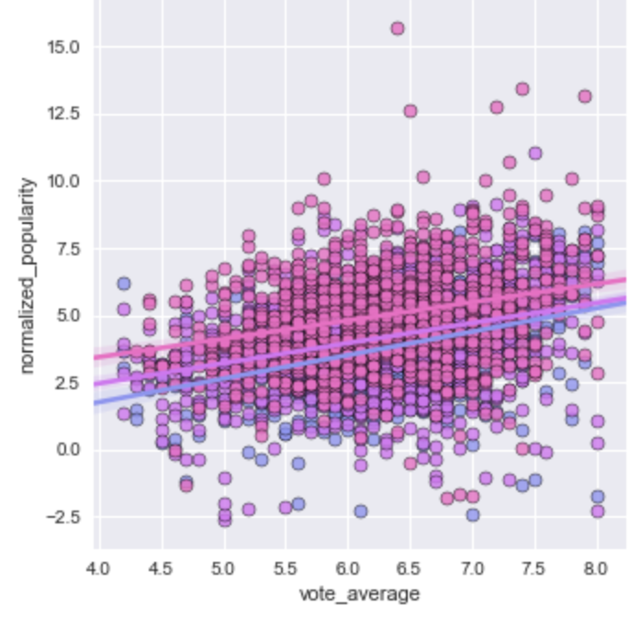
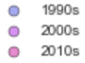
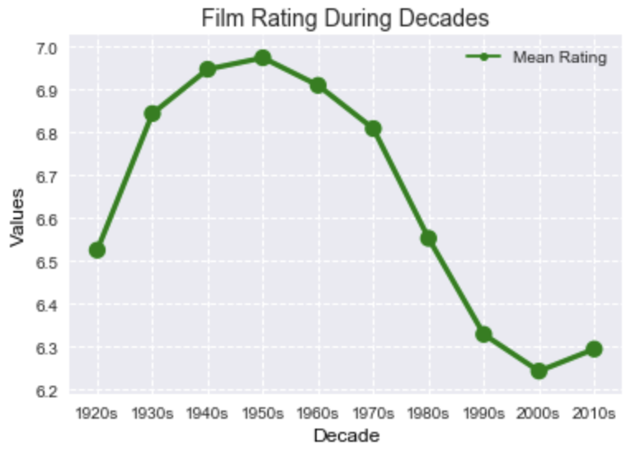
Popularity & Rating
Data Analysis

Slide 22
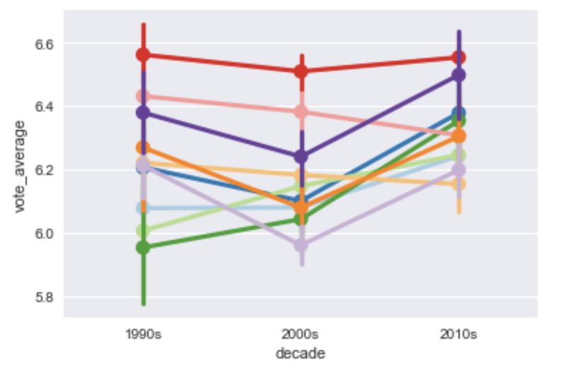
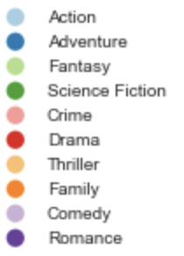
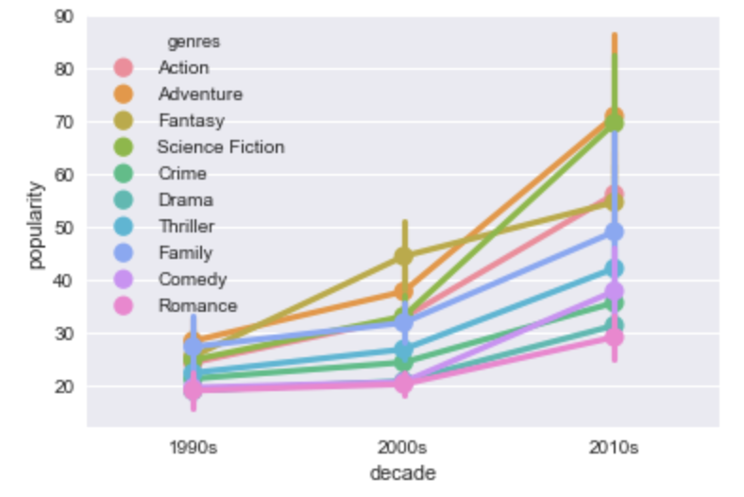
Popularity & Genres
Data Analysis

Slide 23
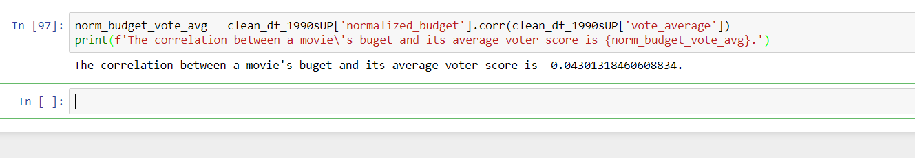
Discussion
Does a higher budget make a better movie?
We see from the low correlation score that a movie’s budget is not correlated with how much a movie is enjoyed

Slide 24
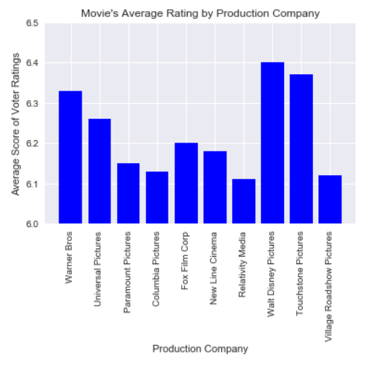
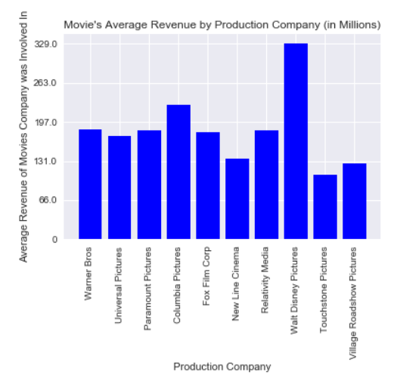
Discussion
Which production company makes the highest average rated movie?
We see from this chart that Disney movies are rated higher than any of the other companies who made the most movies from 1990 to the end of 2017
This is followed closely by Touchstone Picture
Movies are rated on a scale of 1 to 10
All of the companies represented have scores between 6.1 and 6.5

Slide 25
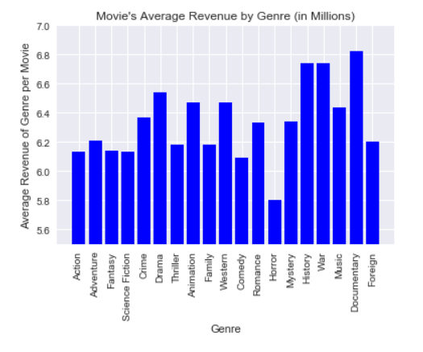
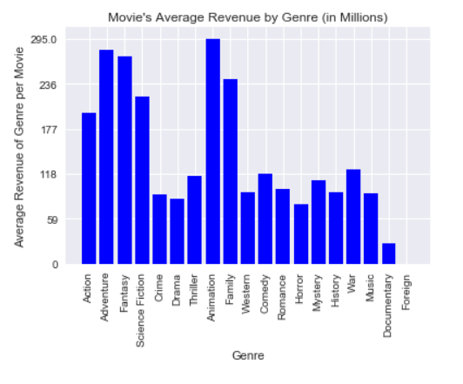
Discussion
Which genres have the highest rated movies?
We see that Documentaries are the most well liked
History and War both come in second in this metric
These three genres are all well researched before being made and are also grounded in reality

Slide 26
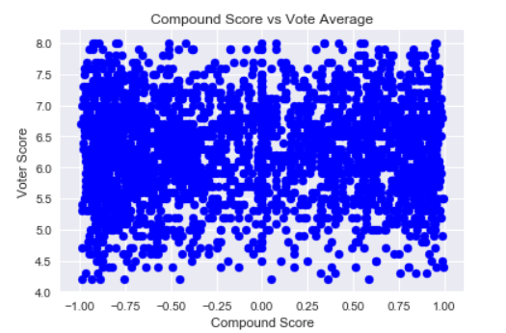

Discussion
Does the positivity of a movie affect its rating?
We see from the scatter plot and the correlation that how positive or negative a movie’s plot is, has an insignificant correlation to how much people enjoy a movie

Slide 27
Final Conclusions / Summary of Major Findings
Every movie is a must watch !? Don’t forget to tweet and give away movie endings! – LOL!
Twitter was only made available last decade but movies have been here since 1927! – LOL!
Budget and Revenue are highly correlated – higher budget movies generated greater revenue upto a max value of 250 M
Popularity of the movie also resulted in higher revenue max 500M
Rating of a movie didn’t largely affect revenue, Marketing(no data), time of release “Month”, year of release also affected data
Higher revenues were generated mostly from “Action” movies
Movies with “Drama” were mostly made
Moves were more popular after 1990’s

Slide 28
Difficulties!
Lack of data sources for complete dataset
Merging issues
Limit of API Calls for data collection
New to Github collaboration/ Slack etc.
Within the datasets:
Dictionaries, that needed sorting and evaluating based off of missing values and characters unrecognizable to pandas dfs

Slide 29
Conclusions/ Future Work/ Roadmap > 2 weeks
Investigating other data sources such as IMDb/ OMDb
Make API Calls to NYTimes / Rotten Tomatoes/ Twitter to see if the Vader Analysis tells us more about how the general public feels about the movies
Build a data model on logistic regression or other predictive models to predict future movie trends in budget, revenue to calculate profits and trends
Compare data based on statistical chi sq or other distributions to evaluate correlation between genres and/or mega blockbusters
Data collection by regions in US with Data/Census
Evaluate with other data analysis softwares including R, SQL

Slide 30
Thank You!
Datadoctors team:
Michael Rutkowski
Jing Xu
Deepa Karnani
"This product uses the TMDb API but is not endorsed or certified by TMDb."
Ashish Nachane
Ruchi Chandra
Aiyana Matthew
Mario Aburto
Kevin Crosby

Slide 31

Film rating, sentiment and popularity change during decade

